Slide 1

Cryptography
Dr. Tran The Son
Notes:
Lecture slides prepared for “Cryptography and Network Security”, 6/e, by William Stallings, Chapter 4 – “Basic Concepts in Number Theory and Finite Fields”.

Slide 2
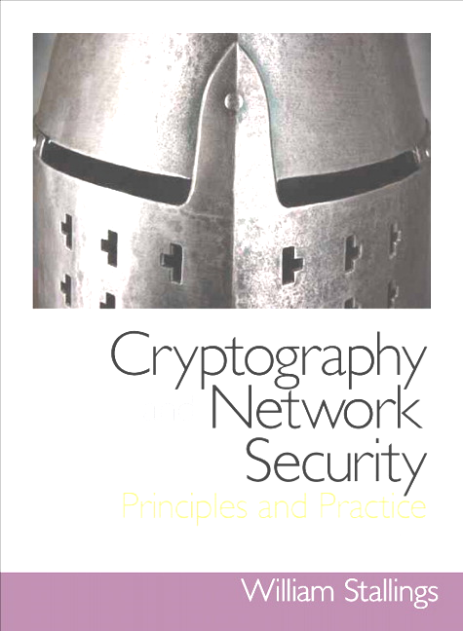
Chapter 4
Block Ciphers and the Data Encryption Standard
Notes:
The objective of this chapter is to illustrate the principles of modern symmetric
ciphers. For this purpose, we focus on the most widely used symmetric cipher: the
Data Encryption Standard (DES). Although numerous symmetric ciphers have been
developed since the introduction of DES, and although it is destined to be replaced
by the Advanced Encryption Standard (AES), DES remains the most important
such algorithm. Furthermore, a detailed study of DES provides an understanding of
the principles used in other symmetric ciphers.
This chapter begins with a discussion of the general principles of symmetric block
ciphers, which are the type of symmetric ciphers studied in this book (with the exception
of the stream cipher RC4 in Chapter 7). Next, we cover full DES. Following this look
at a specific algorithm, we return to a more general discussion of block cipher design.
Compared to public-key ciphers, such as RSA, the structure of DES and most
symmetric ciphers is very complex and cannot be explained as easily as RSA and similar
algorithms. Accordingly, the reader may wish to begin with a simplified version of
DES, which is described in Appendix G. This version allows the reader to perform
encryption and decryption by hand and gain a good understanding of the working of
the algorithm details. Classroom experience indicates that a study of this simplified
version enhances understanding of DES.

Slide 3
Chapter 4: Outline
Traditional Block Cipher Structure
The Data Encryption Standard
A DES Example
The Strength of DES
Block Cipher Design Principles

Slide 4
Stream Cipher
Encrypts a digital data stream one bit or one byte at a time
In the ideal case a one-time pad version of the Vernam cipher would be used, in which the keystream is as long as the plaintext bit stream
For practical reasons the bit-stream generator must be implemented as an algorithmic procedure so that the cryptographic bit stream can be produced by both users
Examples:
  Autokeyed Vigenère cipher
  Vernam cipher
If the cryptographic keystream is random, then this cipher is unbreakable by any means other than acquiring the keystream
  Keystream must be provided to both users in advance via some independent and secure channel
  This introduces insurmountable logistical problems if the intended data traffic is very large
It must be computationally impractical to predict future portions of the bit stream based on previous portions of the bit stream
The two users need only share the generating key and each can produce the keystream
Notes:
A stream cipher is one that encrypts a digital data stream one bit or one byte at
a time. Examples of classical stream ciphers are the autokeyed Vigenère cipher
and the Vernam cipher. In the ideal case, a one-time pad version of the Vernam
cipher would be used (Figure 2.7), in which the keystream (ki ) is as long as the
plaintext bit stream (pi ). If the cryptographic keystream is random, then this cipher
is unbreakable by any means other than acquiring the keystream. However, the
keystream must be provided to both users in advance via some independent and
secure channel. This introduces insurmountable logistical problems if the intended
data traffic is very large.
Accordingly, for practical reasons, the bit-stream generator must be
implemented as an algorithmic procedure, so that the cryptographic bit stream
can be produced by both users. In this approach (Figure 3.1a), the bit-stream
generator is a key-controlled algorithm and must produce a bit stream that is
cryptographically strong. That is, it must be computationally impractical to
predict future portions of the bit stream based on previous portions of the bit
stream. The two users need only share the generating key, and each can produce
the keystream.

Slide 5
Block Cipher
A block of plaintext is treated as a whole and used to produce a ciphertext block of equal length
Typically a block size of 64 or 128 bits is used
As with a stream cipher, the two users share a symmetric encryption key
The majority of network-based symmetric cryptographic applications make use of block ciphers
Notes:
A block cipher is one in which a block of plaintext is treated as a whole
and used to produce a ciphertext block of equal length. Typically, a block size of
64 or 128 bits is used. As with a stream cipher, the two users share a symmetric
encryption key (Figure 3.1b). Using some of the modes of operation explained
in Chapter 6, a block cipher can be used to achieve the same effect as a stream
cipher.
Far more effort has gone into analyzing block ciphers. In general, they seem
applicable to a broader range of applications than stream ciphers. The vast majority
of network-based symmetric cryptographic applications make use of block
ciphers. Accordingly, the concern in this chapter, and in our discussions throughout
the book of symmetric encryption, will primarily focus on block ciphers.

Slide 6
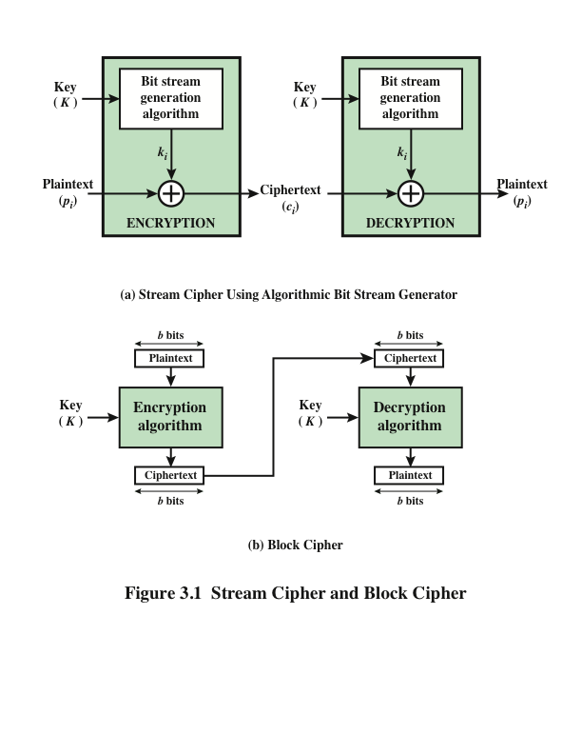
Stream Cipher and Block Cipher
Notes:
Examples of stream and block ciphers.

Slide 7
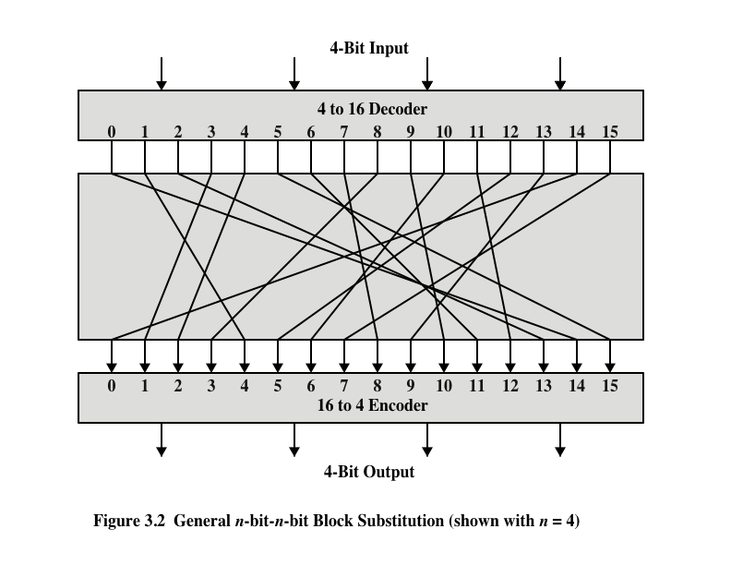
Notes:
A block cipher operates on a plaintext block of n bits to produce a ciphertext
block of n bits. There are 2^{n} possible different plaintext blocks and, for the
encryption to be reversible (i.e., for decryption to be possible), each must produce
a unique ciphertext block. Such a transformation is called reversible, or nonsingular.
Figure 3.2 illustrates the logic of a general substitution cipher for n = 4.
A 4-bit input produces one of 16 possible input states, which is mapped by the substitution
cipher into a unique one of 16 possible output states, each of which is represented
by 4 ciphertext bits.

Slide 8
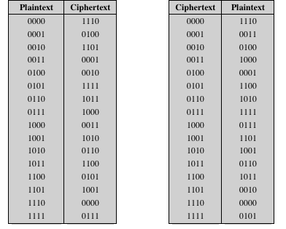
Table 3.1
Encryption and Decryption Tables for Substitution Cipher of Fig 3.2
Notes:
The encryption and decryption mappings can be defined
by a tabulation, as shown in Table 3.1. This is the most general form of block cipher
and can be used to define any reversible mapping between plaintext and ciphertext.
Feistel refers to this as the ideal block cipher , because it allows for the maximum
number of possible encryption mappings from the plaintext block [FEIS75].

Slide 9
Exercise
Mã hóa tên SV theo khối 4 bit
Bằng kỹ thuật thay thế

Slide 10
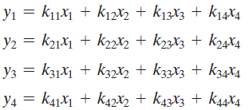
Block substitution problem
The required key length is (4 bits) * (16 rows) = 64 bits

Slide 11
Feistel Cipher
Proposed the use of a cipher that alternates substitutions and permutations
  Is a practical application of a proposal by Claude Shannon to develop a product cipher that alternates confusion and diffusion functions
  Is the structure used by many significant symmetric block ciphers currently in use
Substitutions
  Each plaintext element or group of elements is uniquely replaced by a corresponding ciphertext element or group of elements
Permutation
  No elements are added or deleted or replaced in the sequence, rather the order in which the elements appear in the sequence is changed
Notes:
Feistel proposed [FEIS73] that we can approximate the ideal block cipher by utilizing
the concept of a product cipher, which is the execution of two or more simple ciphers
in sequence in such a way that the final result or product is cryptographically stronger
than any of the component ciphers. The essence of the approach is to develop a block
cipher with a key length of k bits and a block length of n bits, allowing a total of 2^{k}
possible transformations, rather than the 2^{n} ! transformations available with the ideal
block cipher.
In particular, Feistel proposed the use of a cipher that alternates substitutions
and permutations, where these terms are defined as follows:
• Substitution: Each plaintext element or group of elements is uniquely replaced
by a corresponding ciphertext element or group of elements.
• Permutation: A sequence of plaintext elements is replaced by a permutation
of that sequence. That is, no elements are added or deleted or replaced in the
sequence, rather the order in which the elements appear in the sequence is
changed.
In fact, Feistel’s is a practical application of a proposal by Claude Shannon
to develop a product cipher that alternates confusion and diffusion functions
[SHAN49]. We look next at these concepts of diffusion and confusion and then
present the Feistel cipher. But first, it is worth commenting on this remarkable fact:
The Feistel cipher structure, which dates back over a quarter century and which, in
turn, is based on Shannon’s proposal of 1945, is the structure used by many significant
symmetric block ciphers currently in use.

Slide 12
Diffusion and Confusion
Terms introduced by Claude Shannon to capture the two basic building blocks for any cryptographic system
  Shannon’s concern was to thwart cryptanalysis based on statistical analysis
Diffusion
  The statistical structure of the plaintext is dissipated into long-range statistics of the ciphertext
  This is achieved by having each plaintext digit affect the value of many ciphertext digits
Confusion
  Seeks to make the relationship between the statistics of the ciphertext and the value of the encryption key as complex as possible
  Even if the attacker can get some handle on the statistics of the ciphertext, the way in which the key was used to produce that ciphertext is so complex as to make it difficult to deduce the key
Notes:
The terms diffusion and confusion were introduced by
Claude Shannon to capture the two basic building blocks for any cryptographic
system [SHAN49]. Shannon’s concern was to thwart cryptanalysis based on statistical
analysis. The reasoning is as follows. Assume the attacker has some knowledge
of the statistical characteristics of the plaintext. For example, in a human-readable
message in some language, the frequency distribution of the various letters may be
known. Or there may be words or phrases likely to appear in the message (probable
words). If these statistics are in any way reflected in the ciphertext, the cryptanalyst
may be able to deduce the encryption key, part of the key, or at least a set of keys
likely to contain the exact key. In what Shannon refers to as a strongly ideal cipher,
all statistics of the ciphertext are independent of the particular key used. The arbitrary
substitution cipher that we discussed previously (Figure 3.2) is such a cipher,
but as we have seen, it is impractical.
Other than recourse to ideal systems, Shannon suggests two methods for
frustrating statistical cryptanalysis: diffusion and confusion. In diffusion , the
statistical structure of the plaintext is dissipated into long-range statistics of the
ciphertext. This is achieved by having each plaintext digit affect the value of many
ciphertext digits; generally, this is equivalent to having each ciphertext digit be
affected by many plaintext digits.
Every block cipher involves a transformation of a block of plaintext into a
block of ciphertext, where the transformation depends on the key. The mechanism
of diffusion seeks to make the statistical relationship between the plaintext and
ciphertext as complex as possible in order to thwart attempts to deduce the key. On
the other hand, confusion seeks to make the relationship between the statistics of
the ciphertext and the value of the encryption key as complex as possible, again to
thwart attempts to discover the key. Thus, even if the attacker can get some handle
on the statistics of the ciphertext, the way in which the key was used to produce that
ciphertext is so complex as to make it difficult to deduce the key. This is achieved by
the use of a complex substitution algorithm. In contrast, a simple linear substitution
function would add little confusion.
As [ROBS95b] points out, so successful are diffusion and confusion in capturing
the essence of the desired attributes of a block cipher that they have become the
cornerstone of modern block cipher design.

Slide 13
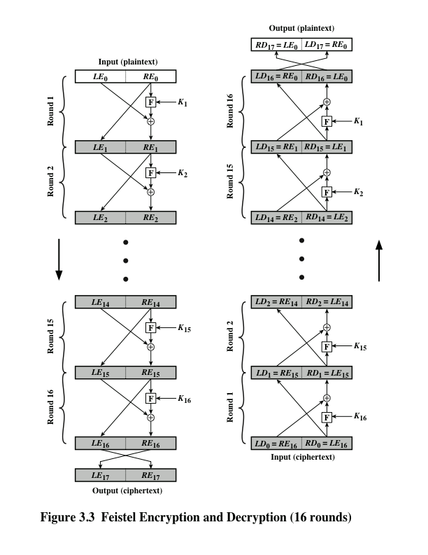
Feistel Cipher Structure
Notes:
The left-hand side of Figure 3.3 depicts the structure
proposed by Feistel. The inputs to the encryption algorithm are a plaintext block of
length 2w bits and a key K . The plaintext block is divided into two halves, L₀ and R₀ .
The two halves of the data pass through n rounds of processing and then combine to
produce the ciphertext block. Each round i has as inputs L_{i-1} and R_{i-1} derived from
the previous round, as well as a subkey K_{i} derived from the overall K . In general,
the subkeys K_{i} are different from K and from each other. In Figure 3.3, 16 rounds
are used, although any number of rounds could be implemented.
All rounds have the same structure. A substitution is performed on the left half
of the data. This is done by applying a round function F to the right half of the data
and then taking the exclusive-OR of the output of that function and the left half of the
data. The round function has the same general structure for each round but is parameterized
by the round subkey K_{i} . Another way to express this is to say that F is a function
of right-half block of w bits and a subkey of y bits, which produces an output value
of length w bits: F (RE_{i} , K_{i+1} ). Following this substitution, a permutation is performed
that consists of the interchange of the two halves of the data. This structure is a particular
form of the substitution-permutation network (SPN) proposed by Shannon.

Slide 14
Feistel Cipher Design Features
Block size
  Larger block sizes mean greater security but reduced encryption/decryption speed for a given algorithm
Key size
  Larger key size means greater security but may decrease encryption/decryption speeds
Number of rounds
  The essence of the Feistel cipher is that a single round offers inadequate security but that multiple rounds offer increasing security
Subkey generation algorithm
  Greater complexity in this algorithm should lead to greater difficulty of cryptanalysis
Round function F
  Greater complexity generally means greater resistance to cryptanalysis
Fast software encryption/decryption
  In many cases, encrypting is embedded in applications or utility functions in such a way as to preclude a hardware implementation; accordingly, the speed of execution of the algorithm becomes a concern
Ease of analysis
  If the algorithm can be concisely and clearly explained, it is easier to analyze that algorithm for cryptanalytic vulnerabilities and therefore develop a higher level of assurance as to its strength
Notes:
The exact realization of a Feistel network depends on the choice of the following
parameters and design features:
• Block size: Larger block sizes mean greater security (all other things being
equal) but reduced encryption/decryption speed for a given algorithm. The
greater security is achieved by greater diffusion. Traditionally, a block size of
64 bits has been considered a reasonable tradeoff and was nearly universal in
block cipher design. However, the new AES uses a 128-bit block size.
• Key size: Larger key size means greater security but may decrease encryption/
decryption speed. The greater security is achieved by greater resistance to
brute-force attacks and greater confusion. Key sizes of 64 bits or less are now
widely considered to be inadequate, and 128 bits has become a common size.
• Number of rounds: The essence of the Feistel cipher is that a single round
offers inadequate security but that multiple rounds offer increasing security.
A typical size is 16 rounds.
• Subkey generation algorithm: Greater complexity in this algorithm should
lead to greater difficulty of cryptanalysis.
• Round function F: Again, greater complexity generally means greater resistance
to cryptanalysis.
There are two other considerations in the design of a Feistel cipher:
• Fast software encryption/decryption: In many cases, encryption is embedded in
applications or utility functions in such a way as to preclude a hardware implementation.
Accordingly, the speed of execution of the algorithm becomes a
concern.
• Ease of analysis: Although we would like to make our algorithm as difficult as
possible to cryptanalyze, there is great benefit in making the algorithm easy to
analyze. That is, if the algorithm can be concisely and clearly explained, it is
easier to analyze that algorithm for cryptanalytic vulnerabilities and therefore
develop a higher level of assurance as to its strength. DES, for example, does
not have an easily analyzed functionality.

Slide 15
Chứng minh mã Feistel
  Trang 127, 128 của sách GK.

Slide 16
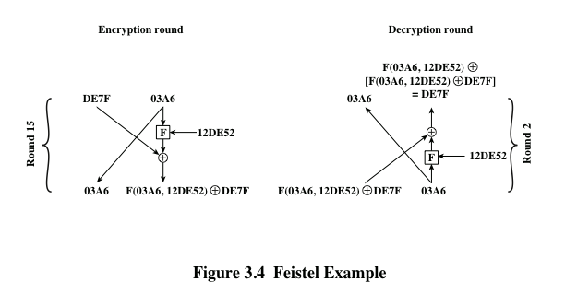
Feistel Example
Notes:
The process of decryption with a Feistel cipher
is essentially the same as the encryption process. The rule is as follows: Use the
ciphertext as input to the algorithm, but use the subkeys K_{i} in reverse order. That
is, use K_{n} in the first round, K_{n-1} in the second round, and so on, until K₁ is used in
the last round. This is a nice feature, because it means we need not implement two
different algorithms; one for encryption and one for decryption.

Slide 17
Exercise
Read and explain code
  https://www.geeksforgeeks.org/feistel-cipher/
Thực hiện thêm 1 round (thứ 3) nữa cho mã Feistel cung cấp ở trên
  Gửi kq lên e-learning

Slide 18
Data Encryption Standard (DES)
Issued in 1977 by the National Bureau of Standards (now NIST) as Federal Information Processing Standard 46
Was the most widely used encryption scheme until the introduction of the Advanced Encryption Standard (AES) in 2001
Algorithm itself is referred to as the Data Encryption Algorithm (DEA)
  Data are encrypted in 64-bit blocks using a 56-bit key
  The algorithm transforms 64-bit input in a series of steps into a 64-bit output
  The same steps, with the same key, are used to reverse the encryption
Notes:
Until the introduction of the Advanced Encryption Standard (AES) in 2001, the
Data Encryption Standard (DES) was the most widely used encryption scheme.
DES was issued in 1977 by the National Bureau of Standards, now the National
Institute of Standards and Technology (NIST), as Federal Information Processing
Standard 46 (FIPS PUB 46). The algorithm itself is referred to as the Data
Encryption Algorithm (DEA). For DEA, data are encrypted in 64-bit blocks using
a 56-bit key. The algorithm transforms 64-bit input in a series of steps into a 64-bit
output. The same steps, with the same key, are used to reverse the encryption.
Over the years, DES became the dominant symmetric encryption algorithm,
especially in financial applications. In 1994, NIST reaffirmed DES for federal use
for another five years; NIST recommended the use of DES for applications other
than the protection of classified information. In 1999, NIST issued a new version
of its standard (FIPS PUB 46-3) that indicated that DES should be used only for
legacy systems and that triple DES (which in essence involves repeating the DES
algorithm three times on the plaintext using two or three different keys to produce
the ciphertext) be used. We study triple DES in Chapter 6. Because the underlying
encryption and decryption algorithms are the same for DES and triple DES, it
remains important to understand the DES cipher. This section provides an overview.
For the interested reader, Appendix S provides further detail.

Slide 19
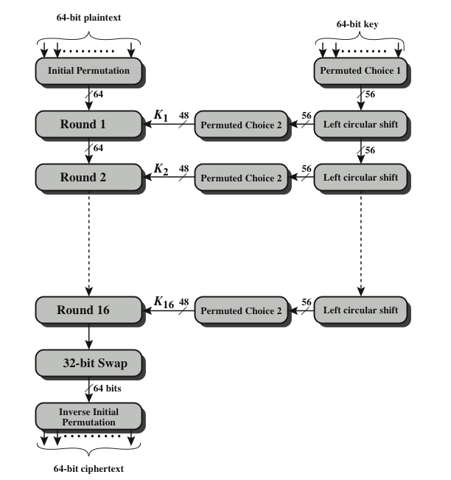
DES Encryption Algorithm
With the exception of the initial and final permutations, DES has the exact structure of a Feistel cipher
Notes:
The overall scheme for DES encryption is illustrated in Figure 3.5. As with any encryption
scheme, there are two inputs to the encryption function: the plaintext to be
encrypted and the key. In this case, the plaintext must be 64 bits in length and the
key is 56 bits in length.
Looking at the left-hand side of the figure, we can see that the processing
of the plaintext proceeds in three phases. First, the 64-bit plaintext passes through
an initial permutation (IP) that rearranges the bits to produce the permuted input .
This is followed by a phase consisting of sixteen rounds of the same function, which
involves both permutation and substitution functions. The output of the last (sixteenth)
round consists of 64 bits that are a function of the input plaintext and the
key. The left and right halves of the output are swapped to produce the preoutput .
Finally, the preoutput is passed through a permutation [IP ⁻¹ ] that is the inverse of
the initial permutation function, to produce the 64-bit ciphertext. With the exception
of the initial and final permutations, DES has the exact structure of a Feistel
cipher, as shown in Figure 3.3.
The right-hand portion of Figure 3.5 shows the way in which the 56-bit key is
used. Initially, the key is passed through a permutation function. Then, for each of
the sixteen rounds, a subkey (K_{i} ) is produced by the combination of a left circular
shift and a permutation. The permutation function is the same for each round, but a
different subkey is produced because of the repeated shifts of the key bits.
As with any Feistel cipher, decryption uses the same algorithm as encryption,
except that the application of the subkeys is reversed. Additionally, the initial and
final permutations are reversed.

Slide 20
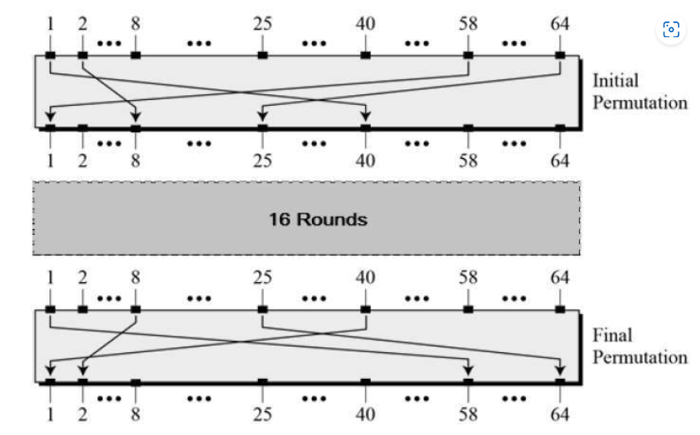
Initial and Final Permutation
P-box

Slide 21
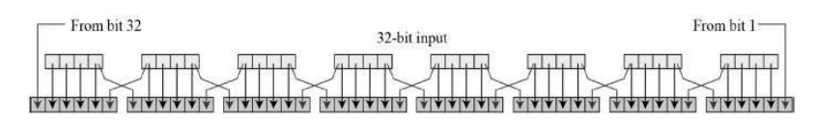
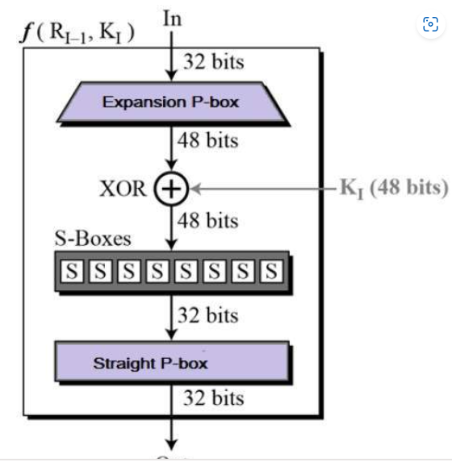
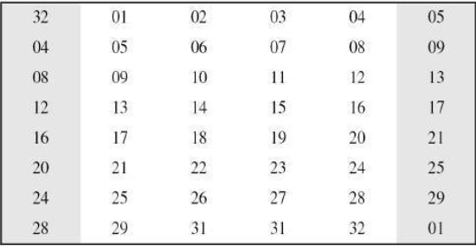
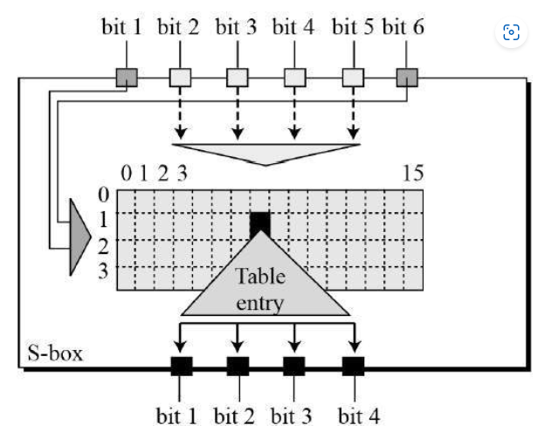
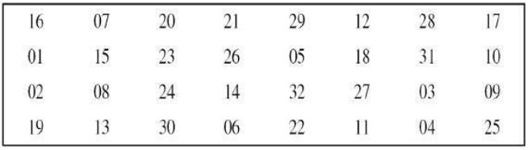
Round Function

Slide 22
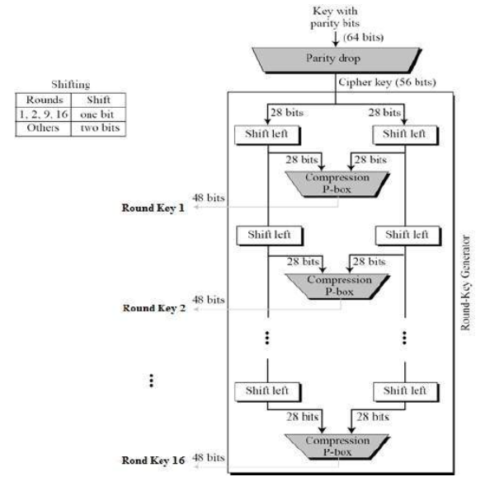
Key Generation

Slide 23
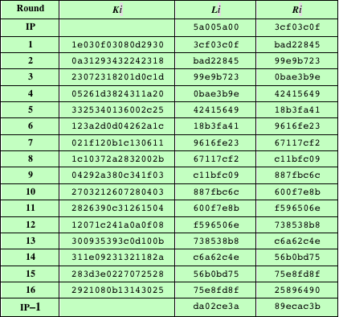
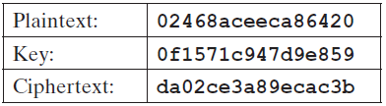
Table 3.2
DES Example
(Table can be found on page 75 in textbook)
Note: DES subkeys are shown as eight 6-bit values in hex format
Notes:
We now work through an example and consider some of its implications. Although
you are not expected to duplicate the example by hand, you will find it informative
to study the hex patterns that occur from one step to the next.
For this example, the plaintext is a hexadecimal palindrome. The plaintext,
key, and resulting ciphertext are as follows:
Plaintext: 02468aceeca86420
Key: 0f1571c947d9e859
Ciphertext: da02ce3a89ecac3b
Table 3.2 shows the progression of the algorithm. The first row shows the 32-bit
values of the left and right halves of data after the initial permutation. The next 16
rows show the results after each round. Also shown is the value of the 48-bit subkey
generated for each round. Note that L_{i} = R_{i-1} . The final row shows the left- and
right-hand values after the inverse initial permutation. These two values combined
form the ciphertext.

Slide 24
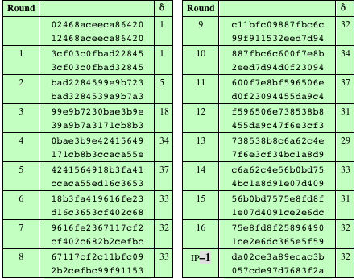

Table 3.3 Avalanche Effect in DES: Change in Plaintext
Avalanche
Effect
in DES
A small change in plaintext results in the very great change in the ciphertext.
Notes:
A desirable property of any encryption algorithm is that a small change in either
the plaintext or the key should produce a significant change in the ciphertext. In
particular, a change in one bit of the plaintext or one bit of the key should produce
a change in many bits of the ciphertext. This is referred to as the avalanche effect. If
the change were small, this might provide a way to reduce the size of the plaintext
or key space to be searched.
Using the example from Table 3.2, Table 3.3 shows the result when the fourth
bit of the plaintext is changed, so that the plaintext is 12468aceeca86420 . The
second column of the table shows the intermediate 64-bit values at the end of each
round for the two plaintexts. The third column shows the number of bits that differ
between the two intermediate values. The table shows that, after just three rounds,
18 bits differ between the two blocks. On completion, the two ciphertexts differ in
32 bit positions.

Slide 25
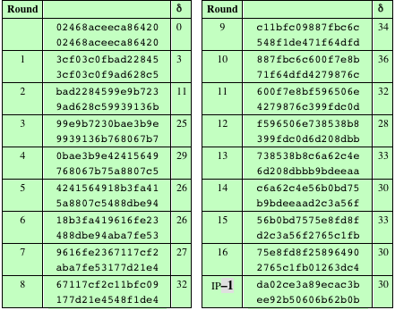
Table 3.4 Avalanche Effect in DES: Change in Key
A small change in plaintext results in the very great change in the ciphertext.
Notes:
Table 3.4 shows a similar test using the original plaintext of with two keys that
differ in only the fourth bit position: the original key, 0f1571c947d9e859 , and
the altered key, 1f1571c947d9e859 . Again, the results show that about half of
the bits in the ciphertext differ and that the avalanche effect is pronounced after just
a few rounds.

Slide 26
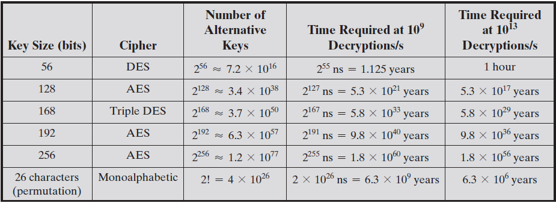
Table 3.5: Average Time Required for Exhaustive Key Search
Notes:
Since its adoption as a federal standard, there have been lingering concerns about
the level of security provided by DES. These concerns, by and large, fall into two
areas: key size and the nature of the algorithm.
With a key length of 56 bits, there are 2⁵⁶ possible keys, which is approximately
7.2 * 10¹⁶ keys. Thus, on the face of it, a brute-force attack appears impractical.
Assuming that, on average, half the key space has to be searched, a single machine
performing one DES encryption per microsecond would take more than a thousand
years to break the cipher.
However, the assumption of one encryption per microsecond is overly conservative.
As far back as 1977, Diffie and Hellman postulated that the technology
existed to build a parallel machine with 1 million encryption devices, each of which
could perform one encryption per microsecond [DIFF77]. This would bring the
average search time down to about 10 hours. The authors estimated that the cost
would be about $20 million in 1977 dollars.
With current technology, it is not even necessary to use special, purpose-built
hardware. Rather, the speed of commercial, off-the-shelf processors threaten the
security of DES. A recent paper from Seagate Technology [SEAG08] suggests that
a rate of 1 billion (10⁹ ) key combinations per second is reasonable for today’s multicore
computers. Recent offerings confirm this. Both Intel and AMD now offer
hardware-based instructions to accelerate the use of AES. Tests run on a contemporary
multicore Intel machine resulted in an encryption rate of about half a billion
encryptions per second [BASU12]. Another recent analysis suggests that with
contemporary supercomputer technology, a rate of 10¹³ encryptions per second is
reasonable [AROR12].
With these results in mind, Table 3.5 shows how much time is required for
a brute-force attack for various key sizes. As can be seen, a single PC can break
DES in about a year; if multiple PCs work in parallel, the time is drastically shortened.
And today’s supercomputers should be able to find a key in about an hour.
Key sizes of 128 bits or greater are effectively unbreakable using simply a brute-force
approach. Even if we managed to speed up the attacking system by a factor
of 1 trillion (10¹² ), it would still take over 100,000 years to break a code using a
128-bit key.
Fortunately, there are a number of alternatives to DES, the most important of
which are AES and triple DES, discussed in Chapters 5 and 6, respectively.

Slide 27

Strength of DES
Timing attacks
  One in which information about the key or the plaintext is obtained by observing how long it takes a given implementation to perform decryptions on various ciphertexts
  Exploits the fact that an encryption or decryption algorithm often takes slightly different amounts of time on different inputs
  So far it appears unlikely that this technique will ever be successful against DES or more powerful symmetric ciphers such as triple DES and AES
Notes:
We discuss timing attacks in more detail in Part Two, as they relate to public-key
algorithms. However, the issue may also be relevant for symmetric ciphers. In essence,
a timing attack is one in which information about the key or the plaintext is obtained
by observing how long it takes a given implementation to perform decryptions on
various ciphertexts. A timing attack exploits the fact that an encryption or decryption
algorithm often takes slightly different amounts of time on different inputs. [HEVI99]
reports on an approach that yields the Hamming weight (number of bits equal to one)
of the secret key. This is a long way from knowing the actual key, but it is an intriguing
first step. The authors conclude that DES appears to be fairly resistant to a successful
timing attack but suggest some avenues to explore. Although this is an interesting line
of attack, it so far appears unlikely that this technique will ever be successful against
DES or more powerful symmetric ciphers such as triple DES and AES.

Slide 28
Block Cipher Design Principles:
Number of Rounds
The greater the number of rounds, the more difficult it is to perform cryptanalysis
In general, the criterion should be that the number of rounds is chosen so that known cryptanalytic efforts require greater effort than a simple brute-force key search attack
If DES had 15 or fewer rounds, differential cryptanalysis would require less effort than a brute-force key search
Notes:
The cryptographic strength of a Feistel cipher derives from three aspects of the
design: the number of rounds, the function F, and the key schedule algorithm. Let
us look first at the choice of the number of rounds.
The greater the number of rounds, the more difficult it is to perform cryptanalysis,
even for a relatively weak F. In general, the criterion should be that the
number of rounds is chosen so that known cryptanalytic efforts require greater
effort than a simple brute-force key search attack. This criterion was certainly used
in the design of DES. Schneier [SCHN96] observes that for 16-round DES, a differential
cryptanalysis attack is slightly less efficient than brute force: The differential
cryptanalysis attack requires 2^{55.1} operations, whereas brute force requires 2⁵⁵ . If
DES had 15 or fewer rounds, differential cryptanalysis would require less effort
than a brute-force key search.
This criterion is attractive, because it makes it easy to judge the strength of
an algorithm and to compare different algorithms. In the absence of a cryptanalytic
breakthrough, the strength of any algorithm that satisfies the criterion can be
judged solely on key length.

Slide 29
Block Cipher Design Principles:
Design of Function F
The heart of a Feistel block cipher is the function F
  The more nonlinear F, the more difficult any type of cryptanalysis will be
The SAC and BIC criteria appear to strengthen the effectiveness of the confusion function
The algorithm should have good avalanche properties
Strict avalanche criterion (SAC)
Bit independence criterion (BIC)
States that any output bit j of an S-box should change with probability 1/2 when any single input bit i is inverted for all i , j
States that output bits j and k should change independently when any single input bit i is inverted for all i , j, and k
Notes:
The heart of a Feistel block cipher is the function F, which provides the element
of confusion in a Feistel cipher. Thus, it must be difficult to “unscramble” the
substitution performed by F. One obvious criterion is that F be nonlinear, as we
discussed previously. The more nonlinear F, the more difficult any type of cryptanalysis
will be. There are several measures of nonlinearity, which are beyond
the scope of this book. In rough terms, the more difficult it is to approximate F
by a set of linear equations, the more nonlinear F is.
Several other criteria should be considered in designing F. We would like the
algorithm to have good avalanche properties. Recall that, in general, this means that
a change in one bit of the input should produce a change in many bits of the output.
A more stringent version of this is the strict avalanche criterion (SAC) [WEBS86],
which states that any output bit j of an S-box (see Appendix S for a discussion of
S-boxes) should change with probability 1/2 when any single input bit i is inverted
for all i , j . Although SAC is expressed in terms of S-boxes, a similar criterion could
be applied to F as a whole. This is important when considering designs that do not
include S-boxes.
Another criterion proposed in [WEBS86] is the bit independence criterion
(BIC) , which states that output bits j and k should change independently when any
single input bit i is inverted for all i , j , and k . The SAC and BIC criteria appear to
strengthen the effectiveness of the confusion function.

Slide 30
Block Cipher Design Principles:
Key Schedule Algorithm
With any Feistel block cipher, the key is used to generate one subkey for each round
In general, we would like to select subkeys to maximize the difficulty of deducing individual subkeys and the difficulty of working back to the main key
It is suggested that, at a minimum, the key schedule should guarantee key/ciphertext Strict Avalanche Criterion and Bit Independence Criterion
Notes:
With any Feistel block cipher, the key is used to generate one subkey for each
round. In general, we would like to select subkeys to maximize the difficulty of
deducing individual subkeys and the difficulty of working back to the main key. No
general principles for this have yet been promulgated.
Adams suggests [ADAM94] that, at minimum, the key schedule should
guarantee key/ciphertext Strict Avalanche Criterion and Bit Independence
Criterion.

Slide 31
Homework
pyDes:
  install pyDes package in Python/Sage
  Run and explain code for DES encryption
https://www.tutorialspoint.com/cryptography_with_python

Slide 32
Summary
Traditional Block Cipher Structure
  Stream ciphers
  Block ciphers
  Feistel cipher
The Data Encryption Standard (DES)
  Encryption
  Decryption
  Avalanche effect
The strength of DES
  Use of 56-bit keys
  Nature of the DES algorithm
  Timing attacks
Block cipher design principles
  DES design criteria
  Number of rounds
  Design of function F
  Key schedule algorithm
Notes:
Chapter 3 summary.

